Slide 1
Making use of this deck
The content captured in this deck is intended for the trainer only
Some of the slides in this deck may be proprietary and/or confidential to Microsoft – i.e., they are not intended to be shared with customers
Slides included here do not appear in the customer-facing deck – rather, they are provided to the trainer to assist them in preparing for the delivery of the training module by complementing the customer-facing deck
Refer to the notes below each to obtain the rationale for inclusion

Slide 2
Suggested workshop format
Half-day workshop ~4 hours
Presentation & discussion ~1 hour
Guided hands-on session ~3 hours
Note: The customer-centric deck has too many slides for a 1-hour session. Feel free to hide/unhide and/or skip slides based upon the participants’ interests, background, etc.

Slide 3
Additional slides

Slide 4
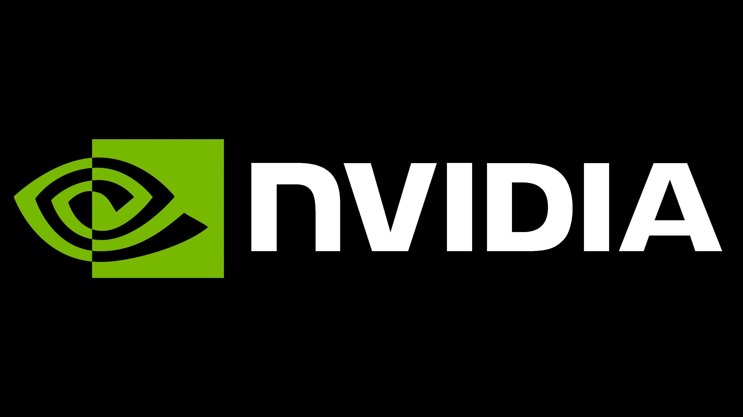
Messaging Elements
An AI-First Infrastructure & Toolchain
INTERNAL REFERENCE DOCUMENT
The messaging elements from this document have been woven into the white paper and decks that have been produced for customer-facing interactions.
Notes:
Today I’m going to share with you our approach for AI and ways in which you can use Azure AI in your business!
<Transition> In fact so many customers are already reaping benefits from their use of Azure AI products

Slide 5
Agenda
Production AI applications are challenging to build & operationalize
AI applications have widely varying training requirements
AI applications have widely varying inferencing requirements
AI applications are challenging to build & operationalize
Notes:
Today I’m going to share with you our approach for AI and ways in which you can use Azure AI in your business!
<Transition> In fact so many customers are already reaping benefits from their use of Azure AI products

Slide 6
Production AI applications are challenging to build & operationalize
Purpose-built IT infrastructure that places AI considerations first is a requirement
Microsoft has been delivering purpose-built IT infrastructure involving GPUs on Azure since 2016 – and their strategic partnership with NVIDIA ensures that this will remain a future-proofed commitment
From Big Data to sophisticated models, AI considerations are data and compute-bound – applies not only to model training but even real-time inferencing
Purpose-built AI infrastructures on Azure reduce the burden on (HPC) IT staff – from CUDA (GPU) drivers and toolchain to low-latency, high-bandwidth interconnect fabrics, isolated to clusters VMs are ready to use for AI workloads
An AI-centric toolchain is a requirement
From prototyping to production, building and operationalizing AI applications requires a comprehensive and powerful toolchain that enables developers of any skill level
Azure Machine Learning on purpose-built AI infrastructures on Azure ensures developers are not distracted by IT – the integrated offering allows developers to take advantage of NVIDIA GPUs for building and operationalizing their applications and/or pipelines
AI-first infrastructures and toolchains ease and accelerate collaboration between application (AI roles/personas) and IT infrastructure (HPC roles/personas) specialists for the organization’s overall benefit
HPC specialists with an expertise in CUDA can leverage their existing knowledge and skills to develop GPU-accelerated libraries in support of AI applications and MLOps

Slide 7
AI applications have widely varying training requirements
Azure provides a ‘spectrum’ of GPU-based VMs that have been purpose-built for all classes of training requirements
The ND Series offering features Infiniband-interconnected VMs built around NVIDIA Ampere A100 GPUs in scale-up-and-out AI supercomputer configurations that can handle current and future-generation Transformer based models for Natural Language Processing (NLP)
NC and ND Series VM offerings feature Kepler, Pascal, and Volta architecture GPUs from NVIDIA for scale-up and scale-up-and-out implementations for basic to mid-range training requirements

Slide 8
AI applications have widely varying inferencing requirements
Azure provides a ‘spectrum’ of GPU-based VMs that have been purpose-built for a variety of inferencing requirements
NV, NC, and ND Series VM offerings feature Maxwell, Kepler, Pascal, Tesla, and Volta architecture GPUs from NVIDIA for real-time to batch inferencing requirements
Azure Stack Edge enables hybrid cloud configurations that extend GPU-based inferencing to on-premises deployments
Fully managed implementations of the NVIDIA Triton Inferencing Server can handle real-time inferencing of streamed video by making use of models trained on Azure

Slide 9
AI applications are challenging to build & operationalize
Azure Machine Learning leverages Azure as its data platform
Azure Machine Learning accommodates developers of any skill level
From low-code and automated options to familiar Notebooks and IDEs, Azure Machine Learning facilitates code development from prototyping to production
Use of familiar interfaces accelerates onboarding to the cloud
Azure Machine Learning simplifies the operationalization of applications and their workflows
Tap into AI-first infrastructure without being distracted by the nuances of cloud-based IT
Manage applications and their workflows throughout their entire lifecycle, and end-to-end, via built-in MLOps
Azure Machine Learning allows to applications to be built, monitored, and refined responsibly

Slide 10
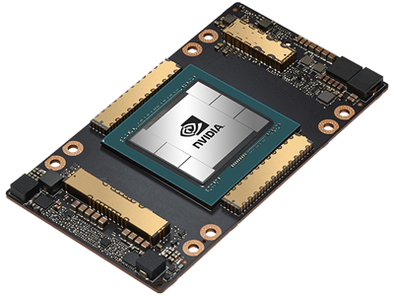
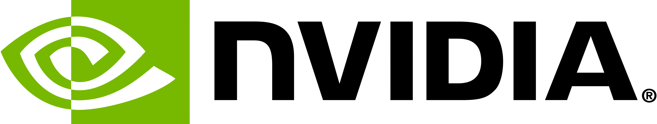

NVIDIA A100 Tensor Core GPU
Flagship NVIDIA offering for Deep Learning, HPC and data analytics at scale
Unprecedented acceleration at every scale
20x higher performance over previous generations
Right-size GPU acceleration with Multi-Instance GPU (MIG)
Available in 40GB and 80GB configurations
80GB version provides fastest memory bandwidth @ 2TB/sec
Multi-GPU interconnections with NVLink + NVSwitch
PCIe Gen 4-based connectivity
200GB InfiniBand HDR link per GPU with NCCL2 and GPUDirect RDMA
Clusters up to ~2K GPUs featuring any to any/all to all communications to host CPUs
Nominal per-GPU performance of 1.7x – 3x V100
Notes:
9 of 10 supercomputers on the Green500 are making use of the NVIDIA A100 Tensor Core GPU
Each ND A100 v4 series VM is based upon eight NVIDIA Ampere A100 Tensor Core GPUs … in isolation, each of these is 54-billion transistor GPU!
Delivers peak floating point performance metrics in the range of about 10-300 TFLOPS
Possesses 40 GB or 80 GB of HBM2 GPU memory with 1.6 TB/s of GPU memory bandwidth
Offers enhanced support for mixed-precision arithmetic plus sparse tensors
Pairs of NVIDIA Ampere A100 Tensor Core GPUs are interconnected at 600 GB/s via the NVIDIA NVLINK Bridge
Pairs of GPUs are interconnected via NVIDIA NVswitch (based upon the 64GB/s PCIe Gen4 interconnect)
For additional details regarding the Azure ND A100 v4 series VMs see the documentation at https://docs.microsoft.com/en-us/azure/virtual-machines/nda100-v4-series; NVIDIA Ampere A100 Tensor Core GPUs are detailed at https://www.nvidia.com/en-in/data-center/a100/.
TFLOPS refer to a trillion floating point operations per second. For 64-bit floating point precision, the A100 peaks at 9.7 TFLOPS, whereas for the 16-bit FP Tensor Core counterpart this peak value is 312 TFLOPS.
Right-size GPU Acceleration with Multi-Instance GPU (MIG) - enables partitioning a single GPU into as many as 7 independent instances for multiple simultaneous workloads https://www.nvidia.com/en-us/technologies/multi-instance-gpu/

Slide 11

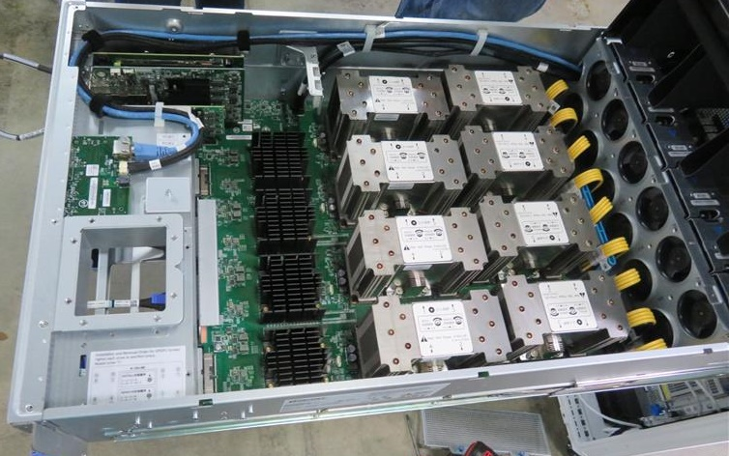
Building scalable supercomputers in the cloud
Single A100 GPU
Multi-GPU VM
NVLINK™
A100 x 8
Multi-GPU VMs
InfiniBand™
A100 x n
NCCL+ NVLink
NCCL+ HDR
Notes:
Pairs of NVIDIA Ampere A100 Tensor Core GPUs are interconnected at 600 GB/s via the NVIDIA NVLINK Bridge
Pairs of GPUs are interconnected via NVIDIA NVswitch (based upon the 64GB/s PCIe Gen4 interconnect)
NVIDIA NCCL provides the software primitives required to make optimal use of this fabric
Mellanox InfiniBand HDR is used as the interconnect fabric
For additional details regarding the Azure ND A100 v4 series VMs see the documentation at https://docs.microsoft.com/en-us/azure/virtual-machines/nda100-v4-series; NVIDIA Ampere A100 Tensor Core GPUs are detailed at https://www.nvidia.com/en-in/data-center/a100/.

Slide 12


Deep Learning/AI: Best choices for optimal GPU utilization
NVIDIA Triton Inference Server
Intelligent Edge
Lightweight GPU devices
NV
NV & NVv3
(Tesla M60)
NC
(Tesla K80)
NC
NCsv2
(Tesla P100)
NCas_T4_v3
(NVIDIA T4 Tensor Core GPU)
NCsv3
(NVIDIA V100 Tensor Core GPU)
ND
(Tesla P40)
NDv2
(NVIDIA V100 Tensor Core GPU)
ND A100 v4
(NVIDIA A100 Tensor Core GPU 40GB)
ND
NDm A100 v4
(NVIDIA A100 Tensor Core GPU 80GB)
Real-Time
Inferencing
Batch
Inferencing
Basic
Training
Midrange
Training
Data-Parallel
Training
Model-Parallel
Training
Notes:
Azure allows GPUs to be optimally mapped to Deep Learning/AI use cases
Applies to deployments in the cloud and at the edge
NV VMs were originally purpose-built for visualization purposes
NC VMs were originally purpose-built for computational (HPC) purposes
Both NV and NC VMs can be re-purposed for AI-oriented use cases
ND VMs were originally purpose-built for Deep Learning purposes
Solutions at the edge need to be factored into many use cases – typically for inferencing purposes
Training is best performed in the cloud (on Azure) – where the most performant VMs are available in scale-up-and-out configurations

Slide 13
Internal stakeholders in organizations considered for customer journey
Know your customer
Envision
Validate
AI applications
AI (HPC) infrastructure
Business Decision Makers
HPC Application Architect (ISVs & in-house
Data Scientist
Cross-cutting/hybrid personas/roles
Technical Computing Engineer
ML Engineer
System Analysts/Administrators
IT Decision Maker
Notes:
Cross-cutting/hybrid personas/roles
Distributed AI specialist
or
Dev(AI)Ops(HPC)

Slide 14
AI vs HPC Expertise
HPC Infra Expert
Pure HPC
Enterprise grade production
AI success
AI Novice
Prototype
AI Experts
Pure AI
HPC Infra Novice

